Slide 1
Google Classroom
How to and Lessons Learned!
Link to presentation: https://goo.gl/7QfAOK

Slide 2
Why Google Classroom?
Google Classroom is a great way to organize student work.
Use Google Classroom to:
Assign, handout, collect, and grade student work.
Send class announcements
Hold class discussions
Students can join the classroom by invitation or class code.
Students can belong to multiple classes for multiple teachers.
Teachers can share classrooms.

Slide 3
Getting Started
Create an account by going to: classroom.google.com
Log in using your gmail account information. The email that you use needs to be part of a school Google for Education domain.
Select “Teacher”
Click on “See How Classroom Works” for a guided tour.
Need help?
Google Classroom Help: Getting Started

Slide 4
Getting Started
You can also install the app from the Chrome Web Store:
Google Classroom Help: Getting Started

Slide 5
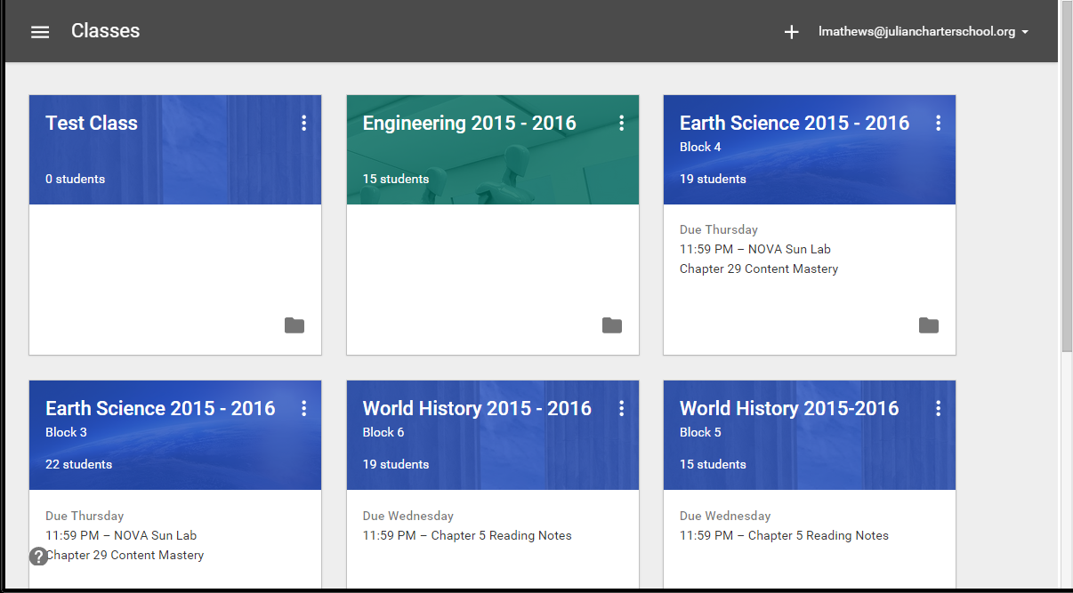
Create a Class
Main Menu
Add a Class

Slide 6
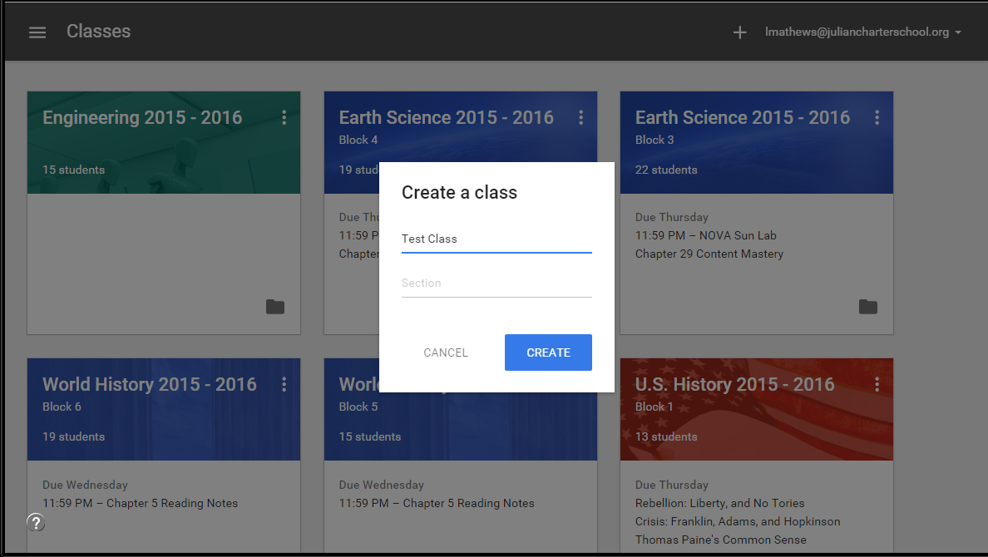
Create a class
Classroom Help: Add a class

Slide 7
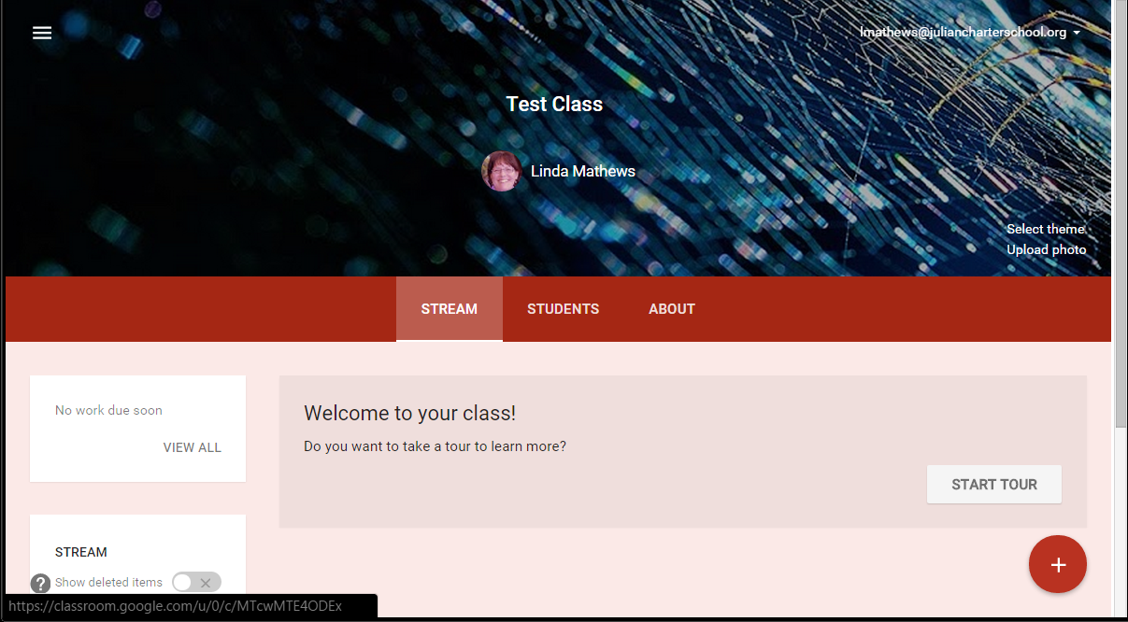
Format a class
Class Name
Main Menu
Edit Theme
Add assignments, announcements, discussions

Slide 8
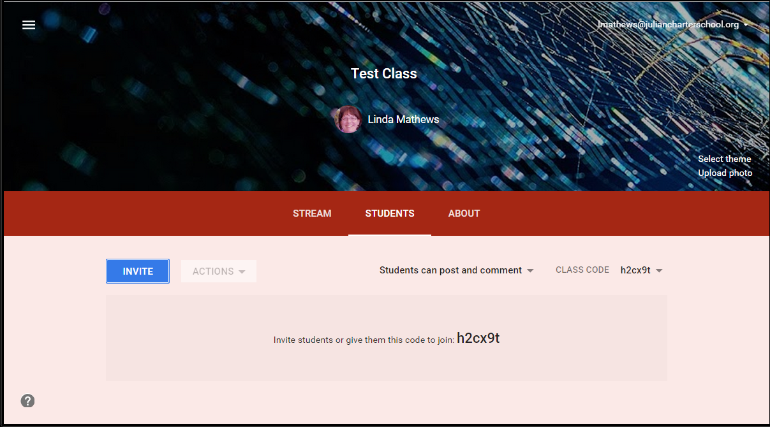
Invite Students
Classroom Help: Student Help
Invite students to join by email.
Select Students
Students can join using class code.

Slide 9
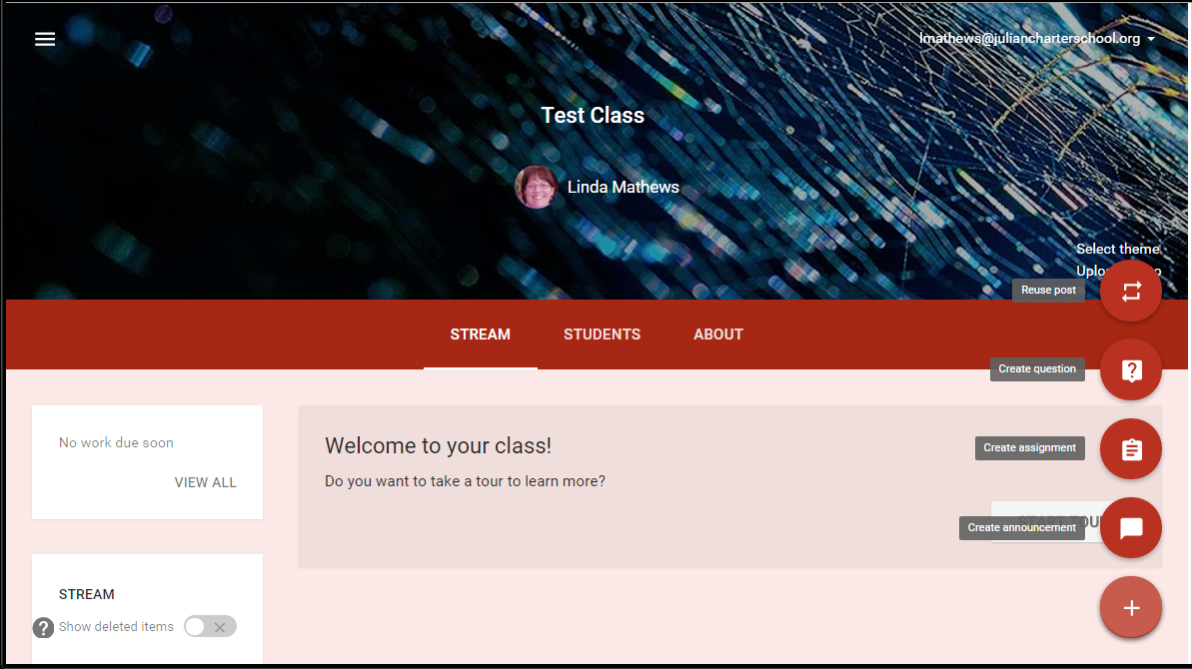
Class Stream
Upcoming Assignments
Add to Stream

Slide 10
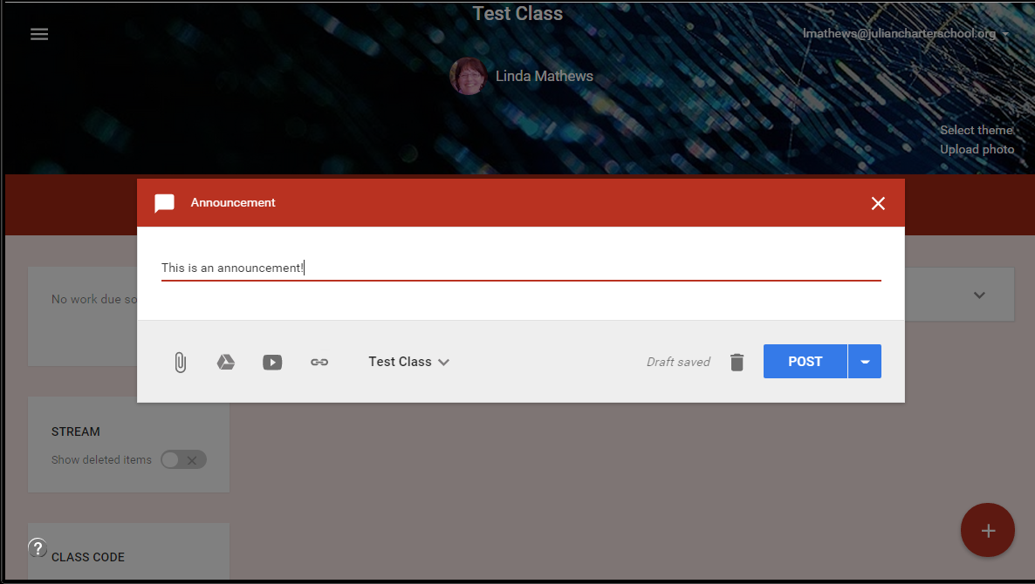
Create Announcement
Classroom Help: Post an announcement
Announcement text
Add attachments
Choose classes to receive announcement
Save draft or post announcement

Slide 11
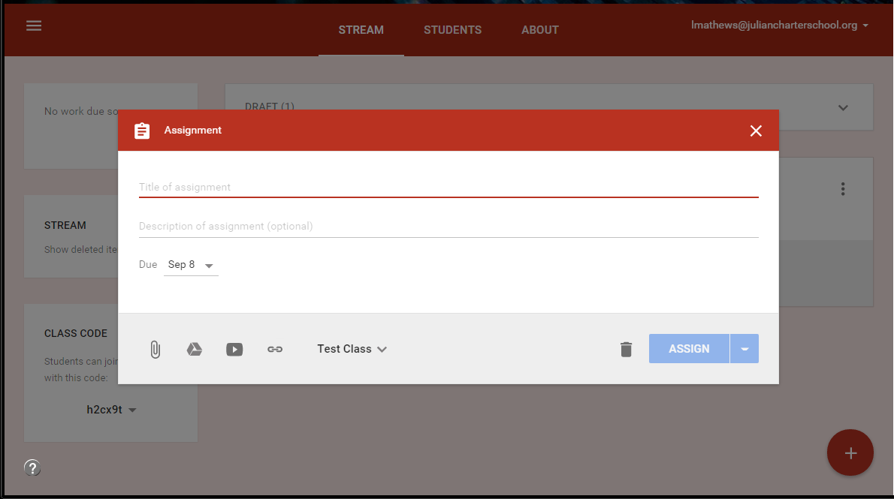
Create Assignment
Classroom Help: Creating and Grading Assignments
Assignment Title
Assignment Description
Due Date and Time
Classes
Attachments

Slide 12
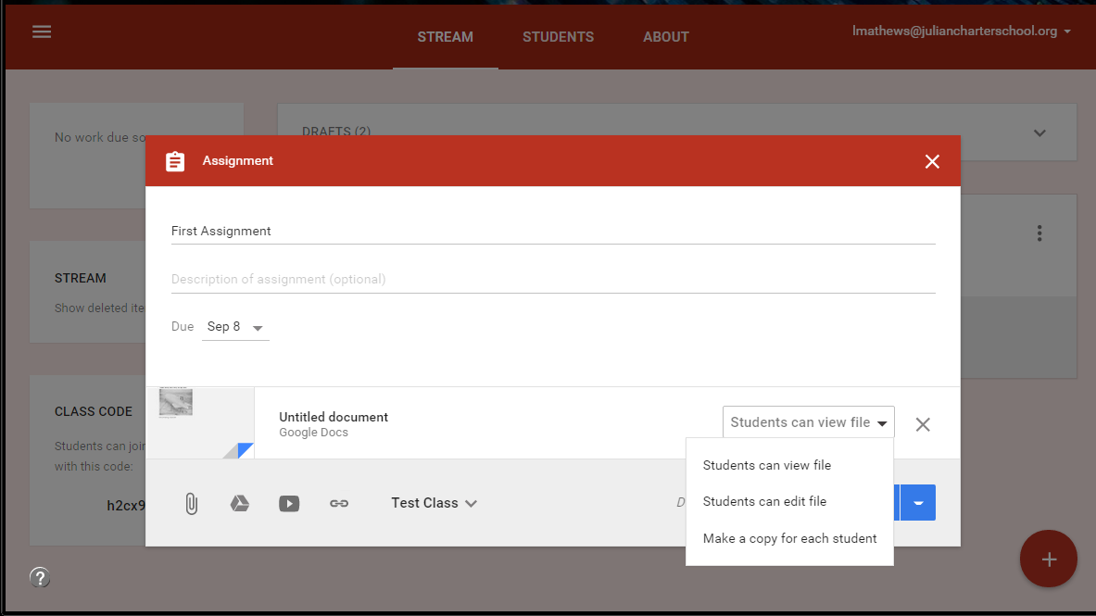
Create Assignment with Handouts
Important: After you create the assignment, you can change student access to a file (view or edit) but you cannot make a copy for each student.

Slide 13
Assignment Features
Do not have to return files when you enter the grades. (Draft grades)
Can send private comments to students via email.
Can create draft assignments to be made public at a later date. Note: This is not automatic - you have to remember to add the assignment at a later date!
Can add documents, links, YouTube videos, and documents to assignments.
Can create assignments without due dates.
Can bump an assignment to the top of the stream.

Slide 14
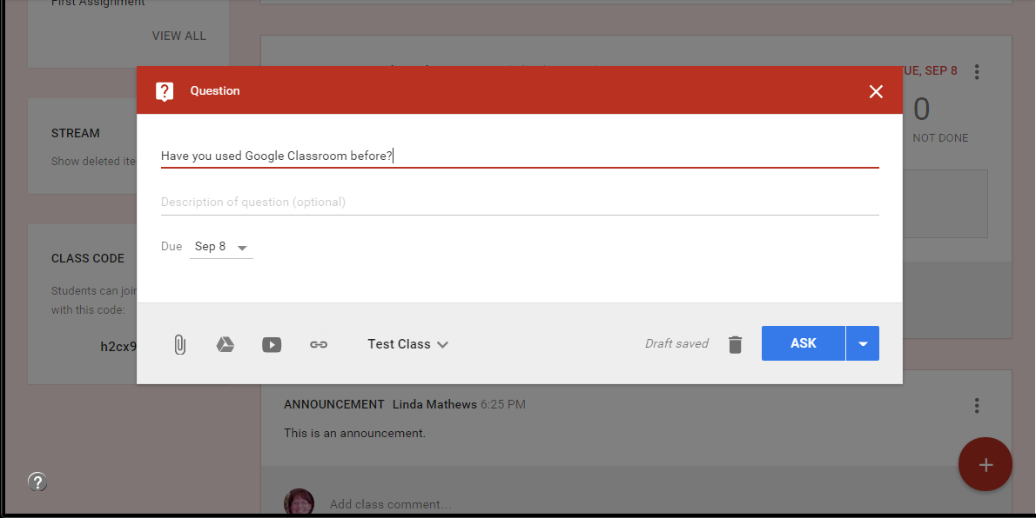
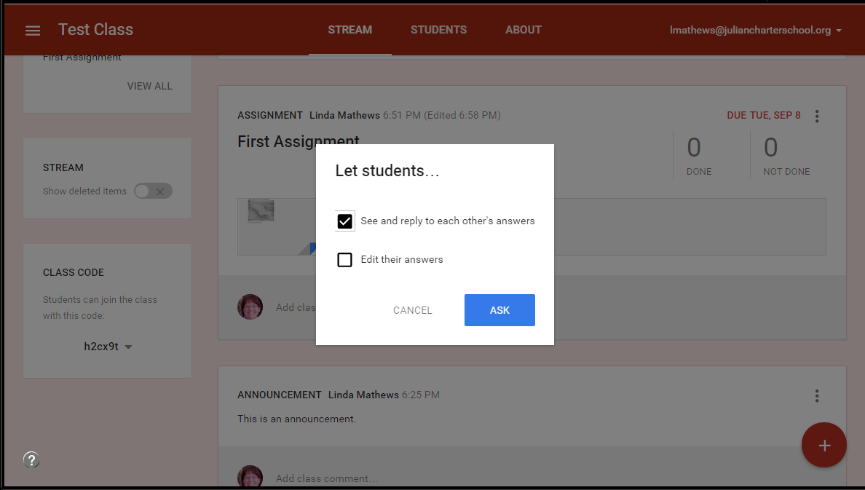
Asking a Question
Discussion question:
2 step process:
First step looks very similar to assignment.
Second step lets you choose access that students have:
to see other replies
students can edit their own replies

Slide 15
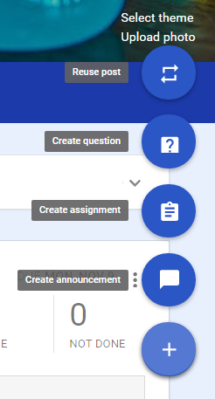
Reuse a Post
Can copy assignments from other classes to current class.
Choose the class
Choose the assignment
Post the assignment

Slide 16
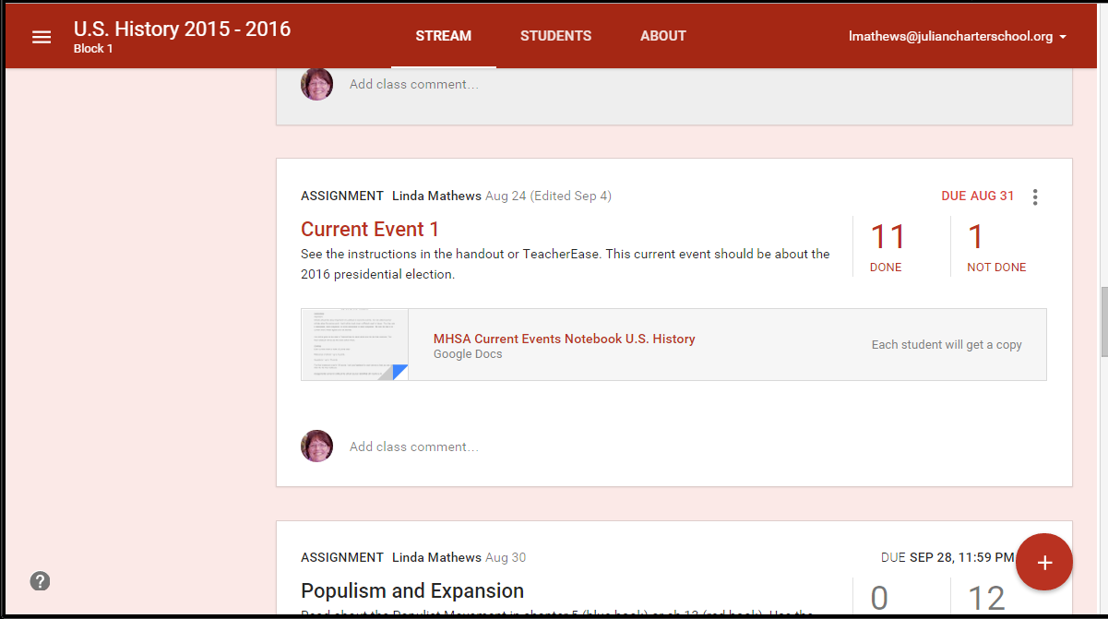
Grading Assignments
To grade assignments, click on the assignment to get list of students and their turned in work.
You can set points, email students, and return work.
Grades can be exported in CSV format.

Slide 17
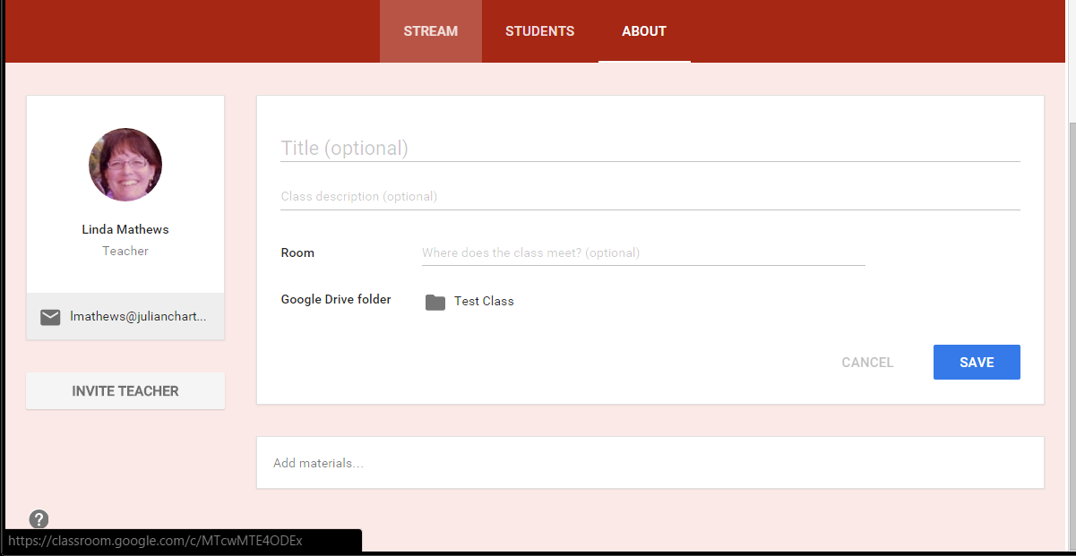
About
Add a class description and other course information.
Share class materials and student work with a co-teacher.
A folder is created for each class in your Google Drive.
Upload class syllabus and other materials/links students need for class

Slide 18
Archiving/Deleting a Class
To archive a class:
Select classes from the main menu
Select the option menu on the class.
Select archive.
Once a class is archived, materials in that class cannot be changed.
You can copy assignments from archived classes.
To delete a class, you must archive it first. The delete option will appear.

Slide 19
Useful Extensions
Share to Classroom
Save to Google Drive

Slide 20
Lessons Learned
Although students are comfortable with phones and games, they are not always familiar with productivity tools. Walk them through Google Classroom several times. (Turninpaloozas, practice assignments)
Need to have a way to indicate in gradebook if assignment is in Google Classroom (ONLINE, GCLASS, INCLASS)
Remind students that turning in assignment is a 2 step process.
Make sure students understand how to access handouts attached to lessons.

Slide 21
More Lessons Learned
Students need a basic understanding of how permissions work on documents turned in. (Long term assignments)
Make sure that students read the notes for assignments.
Think about how you want to deal with assignments turned in to wrong assignment.

Slide 22
Classroom Support
Google has a good Classroom support center:
https://support.google.com/edu/classroom/
Follow the Google Classroom for Education blog:
http://googleforeducation.blogspot.com/
You can also follow the blog on Twitter and Facebook.

Slide 23
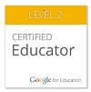
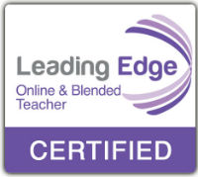
Contact Me
Linda Mathews
Academy Instructor - Murrieta High School Academy
My background: About me
email: lmathews@juliancharterschool.org
website: www.magistramathews.weebly.com
The slide presentation is on my website.

